Slide 1

Shuru krta hun allah ke naam se jo bara meherban aur nihayat reham wala hai
This Photo by Unknown Author is licensed under CC BY-NC-ND

Slide 2

Book Lawyer
Control Your Case At Your Choice

Slide 3

Project Specification
Details
User Types:
Admin: To manage information that we will be seen in homepage and manage lawyer profiles need to be seen for searches. Manage schedules and appointment booking slots
Customer: To search for lawyer services based on requirement.
Module details
Customer / Lawyer registration
Panel for lawyers
Search by lawyer location, lawyer services like Criminal, divorce, affidavit, civil, and then meeting place
View Lawyer profile / Book Appointment
Login through normal registration form for customer is mandatory and for a lawyer registration form is required. Basically user/password required
Showcase of the lawyer when they search one by one
Admin Pages
Features-
Registration for customer as well as Lawyers.
Panel for Lawyers showcasing their details
Search by lawyer location, lawyer services like criminal, divorce, affidavit, civil, and then schedule a meeting with the same.
A customer search will show minimal info of a lawyer related to the service which customer searches, a click on lawyer profile should go to lawyer profile, where in customer can schedule a meeting and book a slot.
Login through normal registration form for customer is mandatory and for a lawyer registration form is required. Basically user/password required.
Showcase of the lawyer when they search one by one.

Slide 4

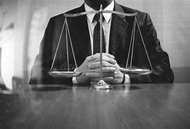
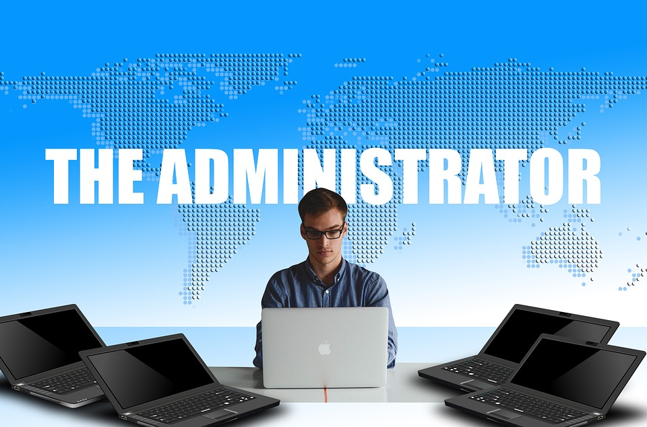
Website Panels
This Photo by Unknown Author is licensed under CC BY-NC
User Interface
Lawyer interface
Admin interface

Slide 5




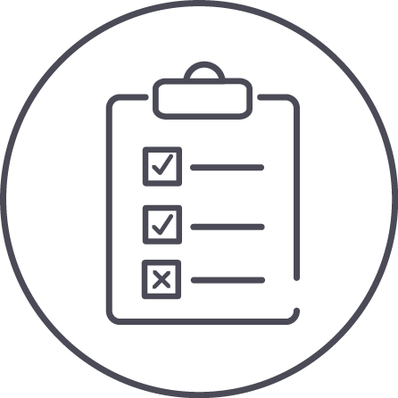


User interface
Website Access
Cancel Appointments
Appointments
Status Checked
Authentication
Appointments check
Lawyer Select
User can Login

Slide 6


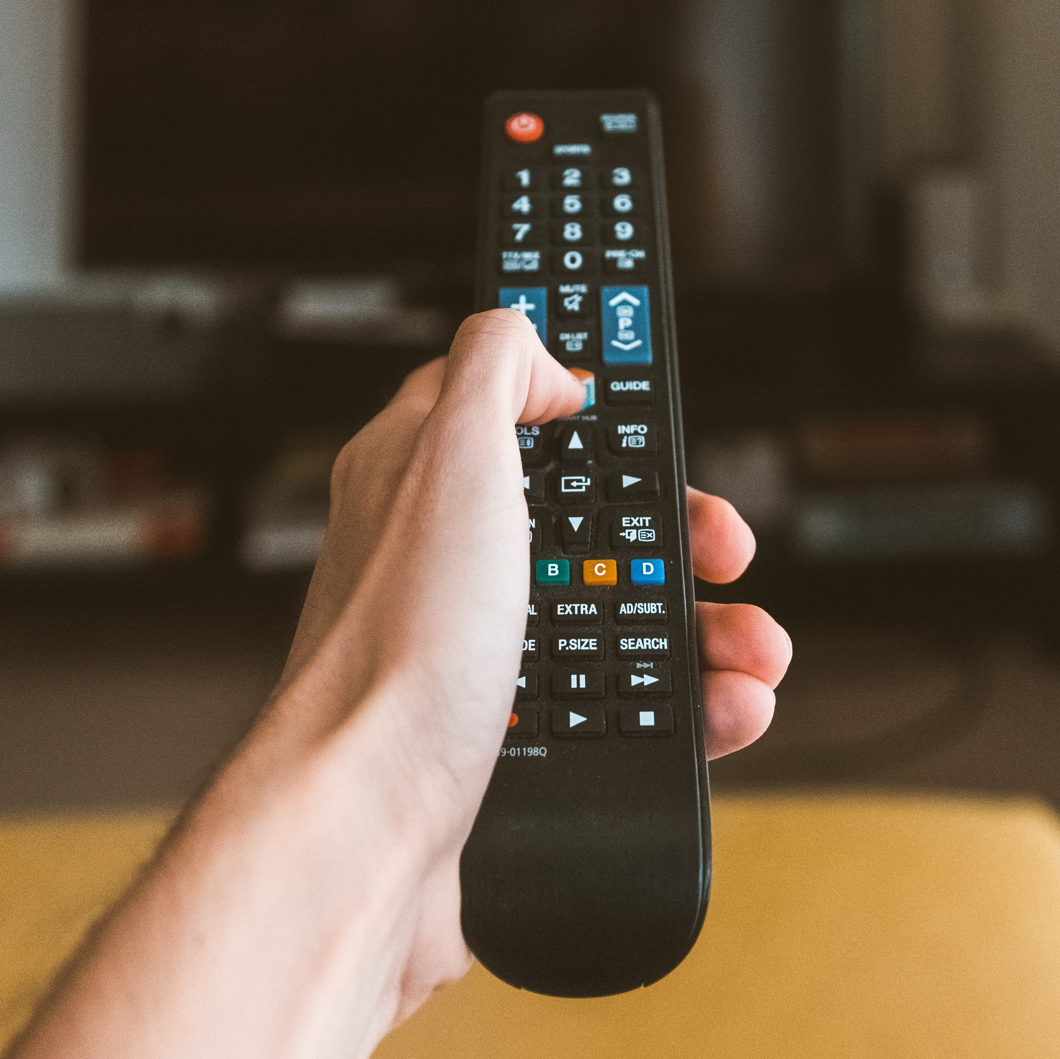
Admin interface
Lawyer
Lawyers control
Lawyer Data
Users Control
Authentication
User Appointments
Status Check
Admin can Login

Slide 7
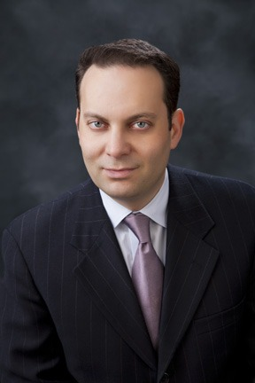



Admin interface
Lawyer
Appointment cancelled
Image select
Appointment Approved
Authentication
User Appointments
Status Check
Lawyer can Login

Slide 8
Thank you

